Slide 1


Slide 2
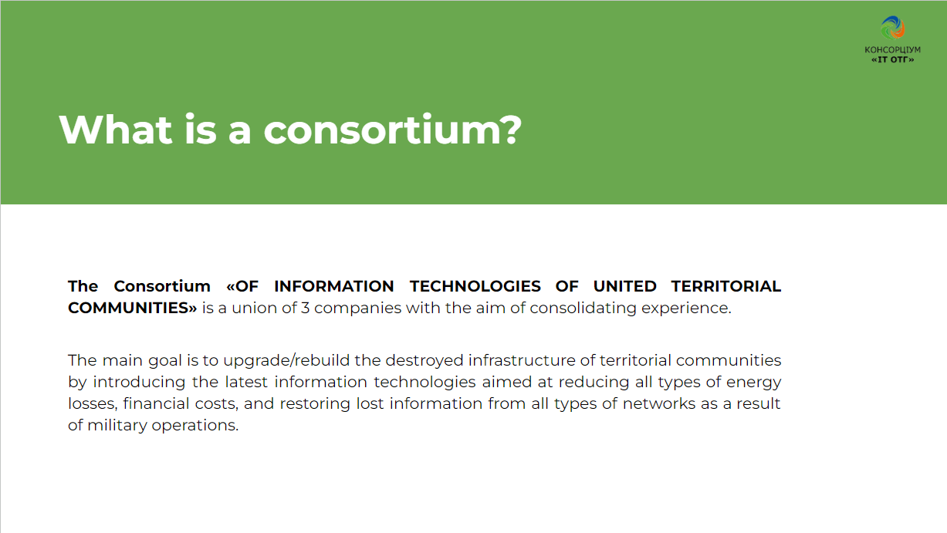

Slide 3
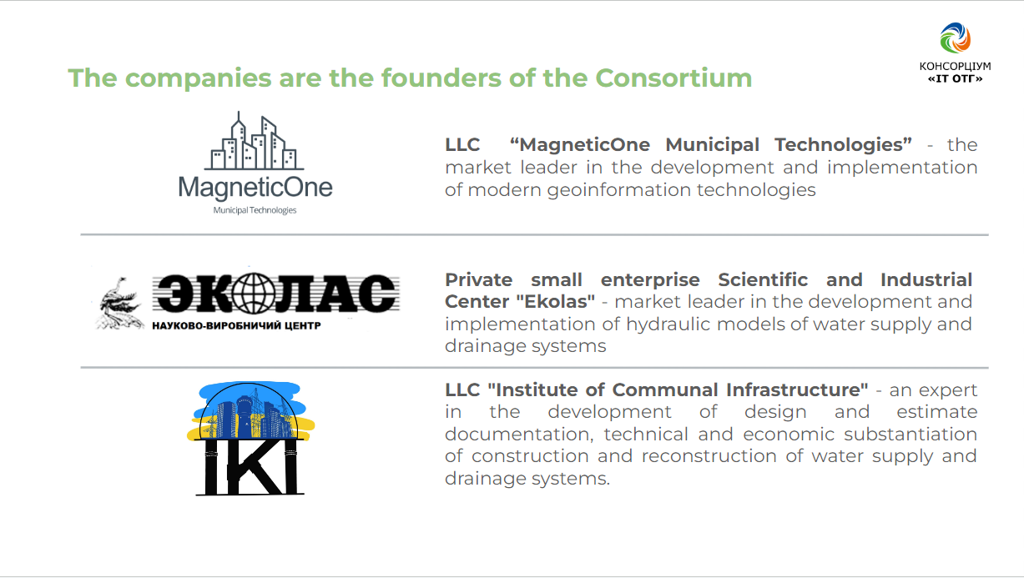

Slide 4
Primary restoration of the water supply network scheme of settlements of any size and complexity in case of loss of information on carriers (electronic, paper) as a result of military operations, namely

Slide 5
Currently, there are several companies in Ukraine that develop classical GIS and hydraulic models based on the creation of detailed maps, the creation of a complete database of networks to each subscriber, field work on the certification of wells, etc. Such work depends on the size of the settlement and takes months and years.
For settlements affected by floods and military operations, there is no such time, and classical methods are not suitable. The issue of providing water to the population must be resolved immediately!
The IT UTC Consortium offers a different approach to solving this problem, less accurate but fast enough.
We offer three options for solving the problem depending on the available information:
Primary restoration of the scheme of water supply networks of settlements of any size and complexity

Slide 6
I. If there is an information base of water supply networks, including hydraulic models
1. Identification and mapping of network sections that have been damaged and assessment of the possibility of their prompt restoration.
2. Identification of network sections that can supply water to consumers.
3. Conducting hydraulic calculations based on the adjusted hydraulic model, taking into account the destroyed sections of the network, to determine the conditions of water supply to consumers and technical solutions to achieve the set goals.
4.If necessary, selecting the optimal power equipment (pumps).

Slide 7
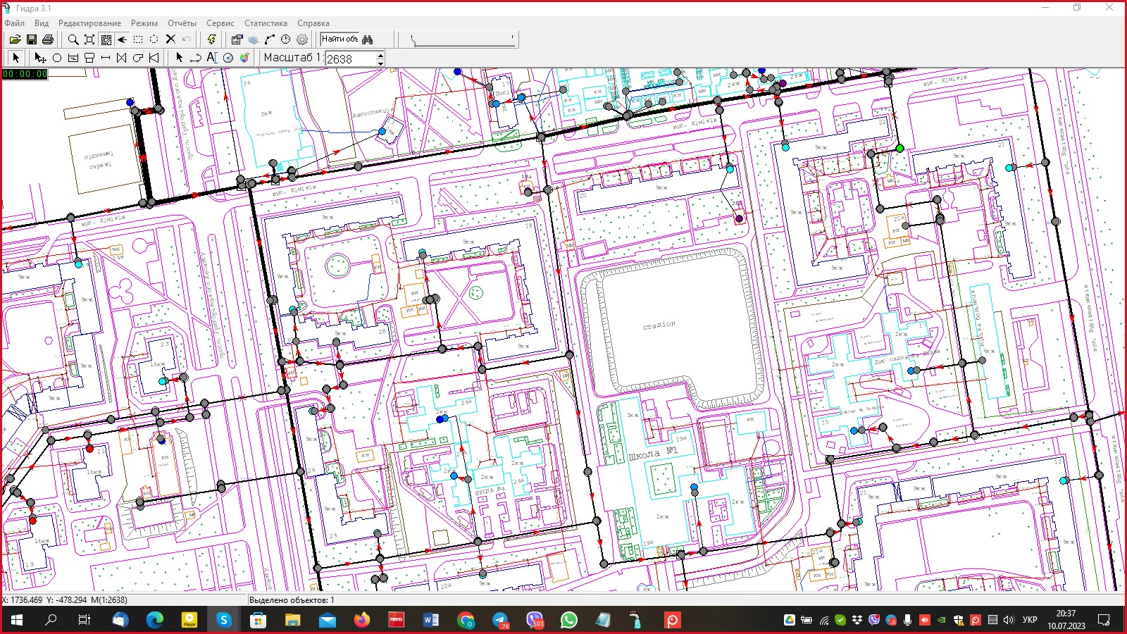
Fig.1.1. Area of the city "N" with the water supply networks and the infrastructure of the city at the beginning of the hostilities.

Slide 8
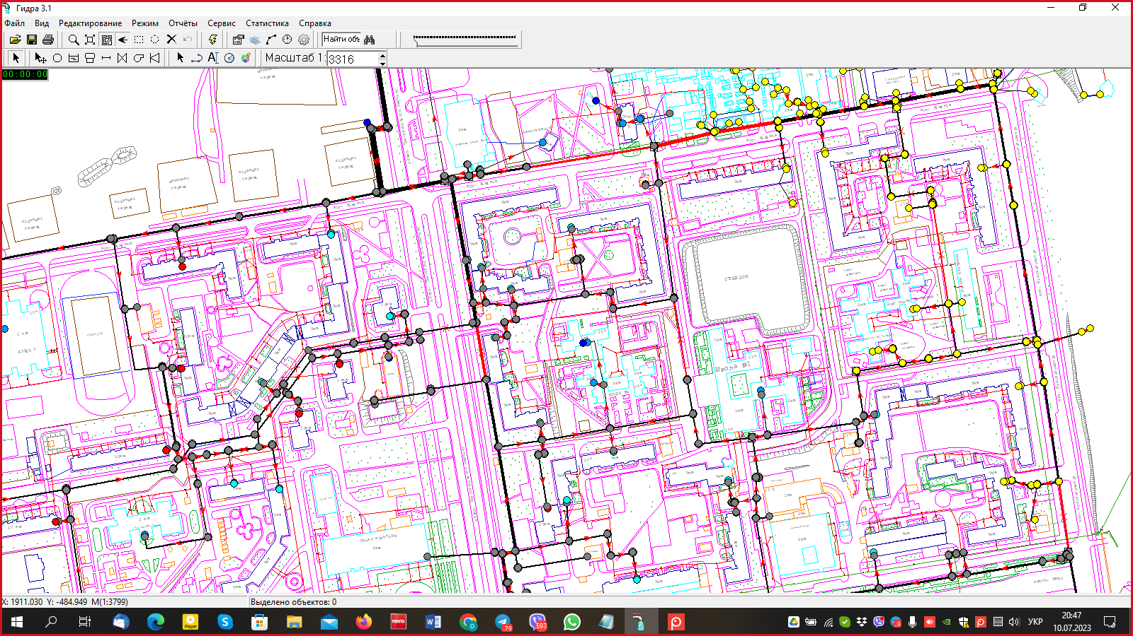
Fig. 1.2. District "N" with identified and mapped sections of the damaged network (marked in red). Yellow dots are consumers without water supply.

Slide 9
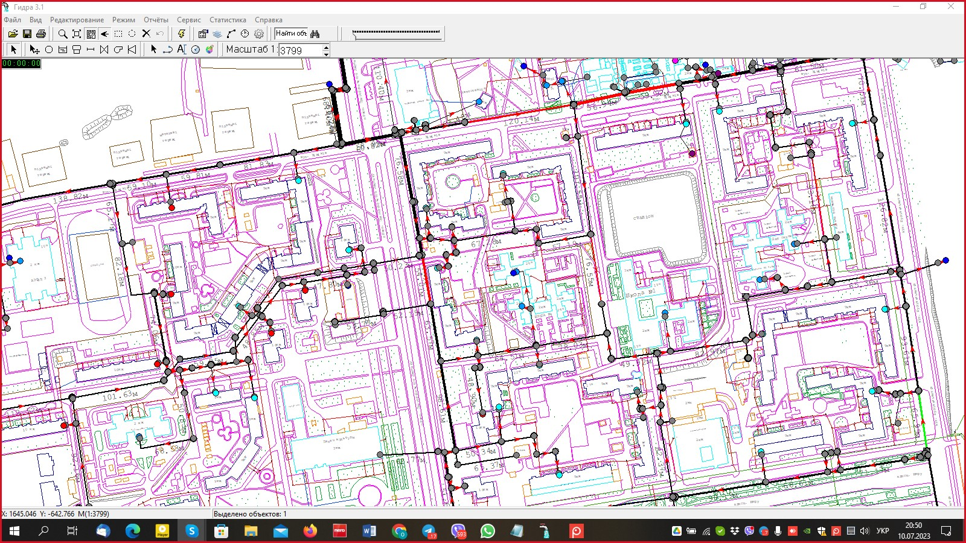
Fig. 1.3. Identification of the destroyed 65.3-meter-long section of the network in the district "N", the replacement of which made it possible to supply water to every consumer.

Slide 10
ІІ. In case of loss of information on carriers (electronic, paper) as a result of military actions, as well as due to the explosion of the Kakhovka HPP, namely
1. In the absence of an electronic map of the city with water supply networks, a Google map of the settlement under consideration is used as a basis.
2. Together with water utility employees who have knowledge of the structure of water supply networks, street networks are laid out on a Google map, indicating water intake, pumping stations and main wells with water distribution valves at the intersection of streets
3. Identification and mapping of network sections that have been damaged, with an assessment of the possibility of their prompt restoration.
4. Identification of network sections that can be used to supply water to consumers.

Slide 11
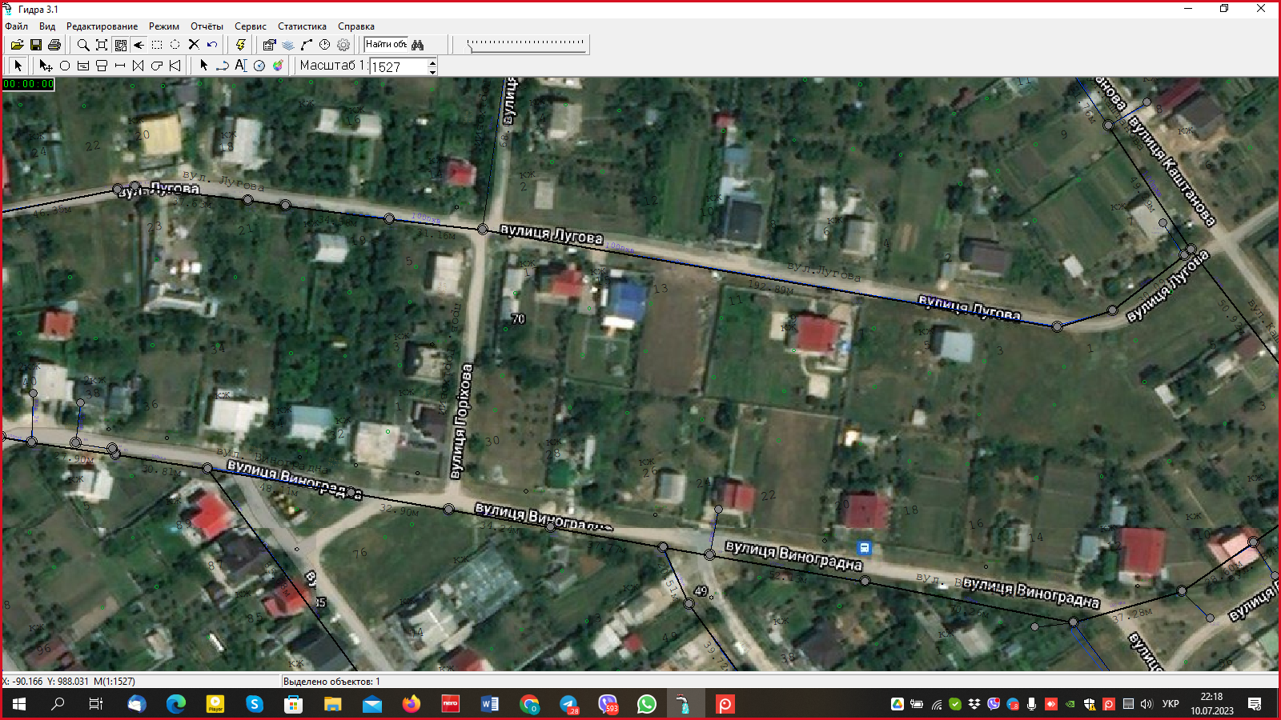
Fig. 2.1. Mapping street water networks on Google Maps with water utility staff

Slide 12
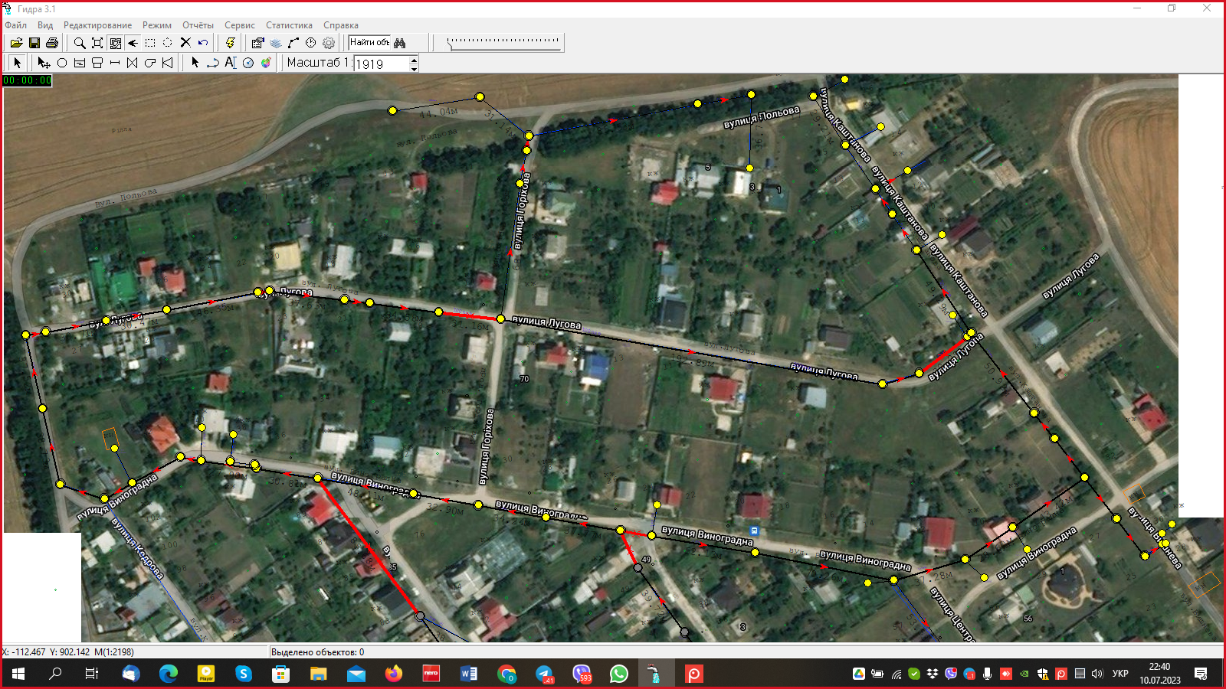
Fig. 2.2. Identification and mapping of the sections of the water supply network that have been damaged (marked in red). Yellow dots are consumers without water supply.

Slide 13
5. Creation of an electronic diagram of water supply networks that can supply water to consumers, indicating the destroyed sections of the network.
6. Development of a simplified hydraulic model of the existing part of the network in order to determine the optimal technical solutions for water supply to consumers
7. Modeling of various options for water supply to consumers, taking into account sanitary requirements (taking into account the condition of the network equipment and water intake).
8. Development of technical measures to reconstruct the network to supply water to areas where it is not available.
9. Selection of the optimal electrical equipment based on the actual situation

Slide 14
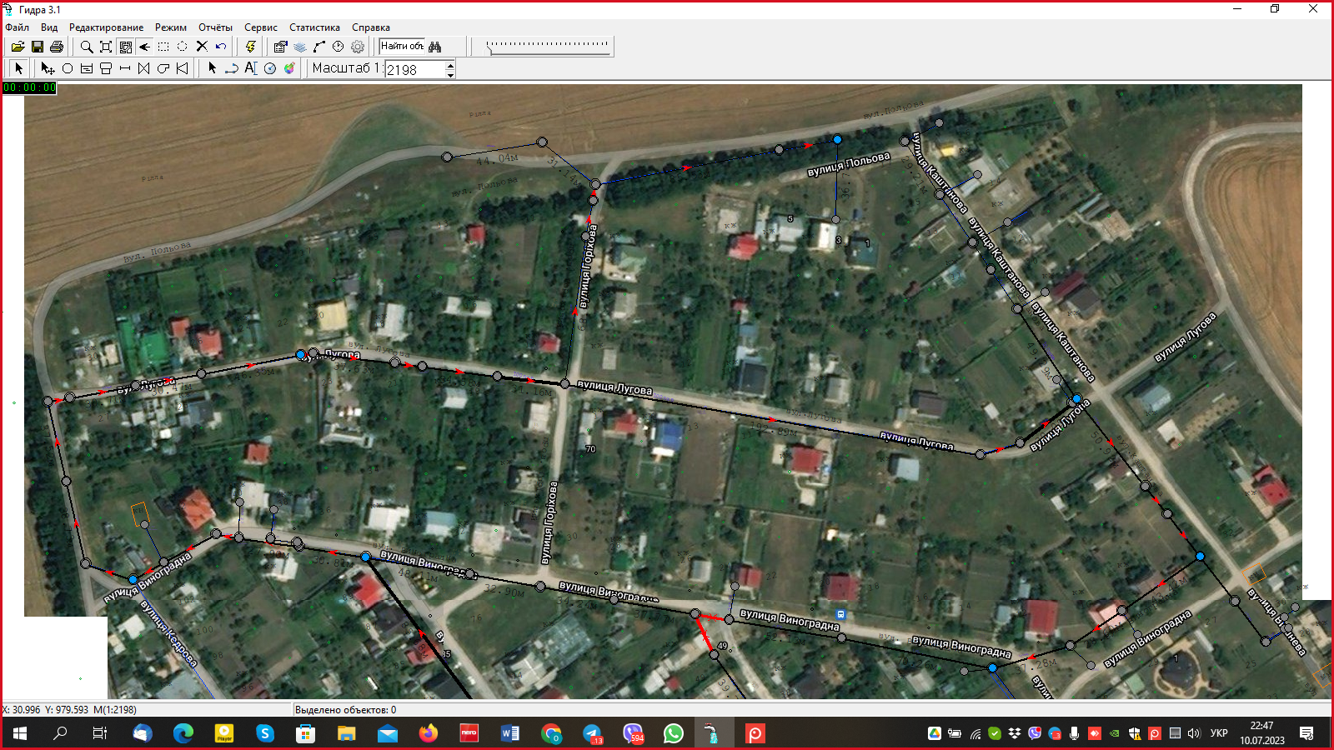
Fig. 2.3. Identification of three destroyed sections of the network of the district with a length of 85.2 m; 31.4 m; 30.14 m, the replacement of which made it possible to supply water to each consumer.

Slide 15
Ⅲ. If there is an information base of networks, but no hydraulic model:
1. Identification and mapping of network sections that have been damaged and assessment of the possibility of their prompt restoration
2. Identification of network sections that can be used to supply water to consumers.
3. Development of a consolidated hydraulic model for street water supply networks.
4. Modeling of various options for water supply to consumers, taking into account sanitary requirements (taking into account the condition of network equipment and water intake).
5. Development of technical measures to reconstruct the network to supply water to areas where it is not available.
6. If necessary, selecting the optimal equipment (pumps).

Slide 16
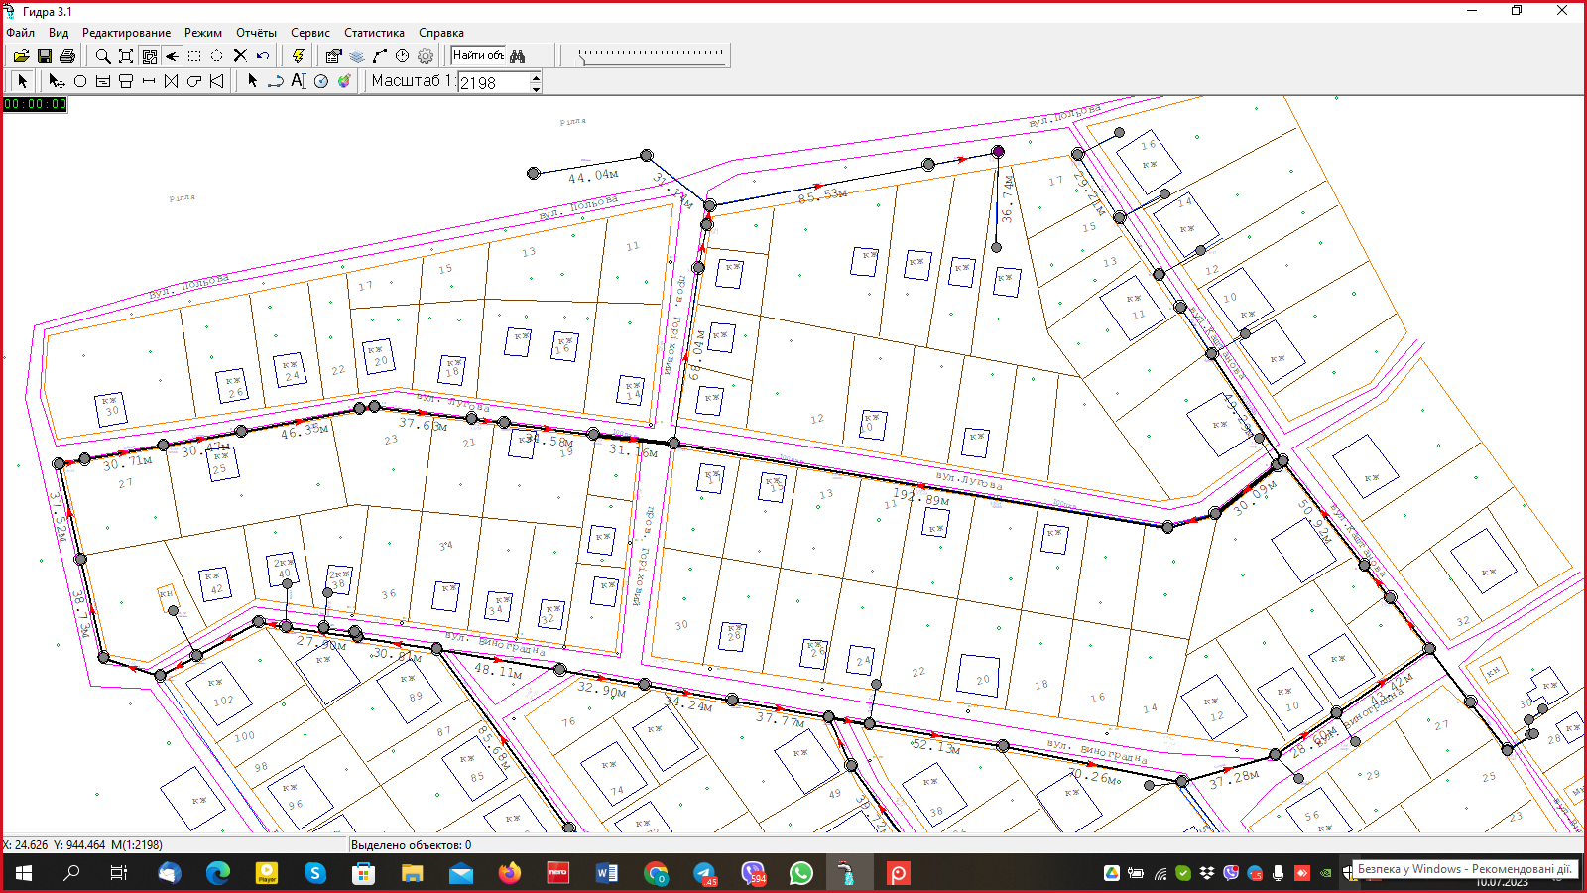
Fig. 3.1. District with water supply networks and urban infrastructure at the start of hostilities.

Slide 17
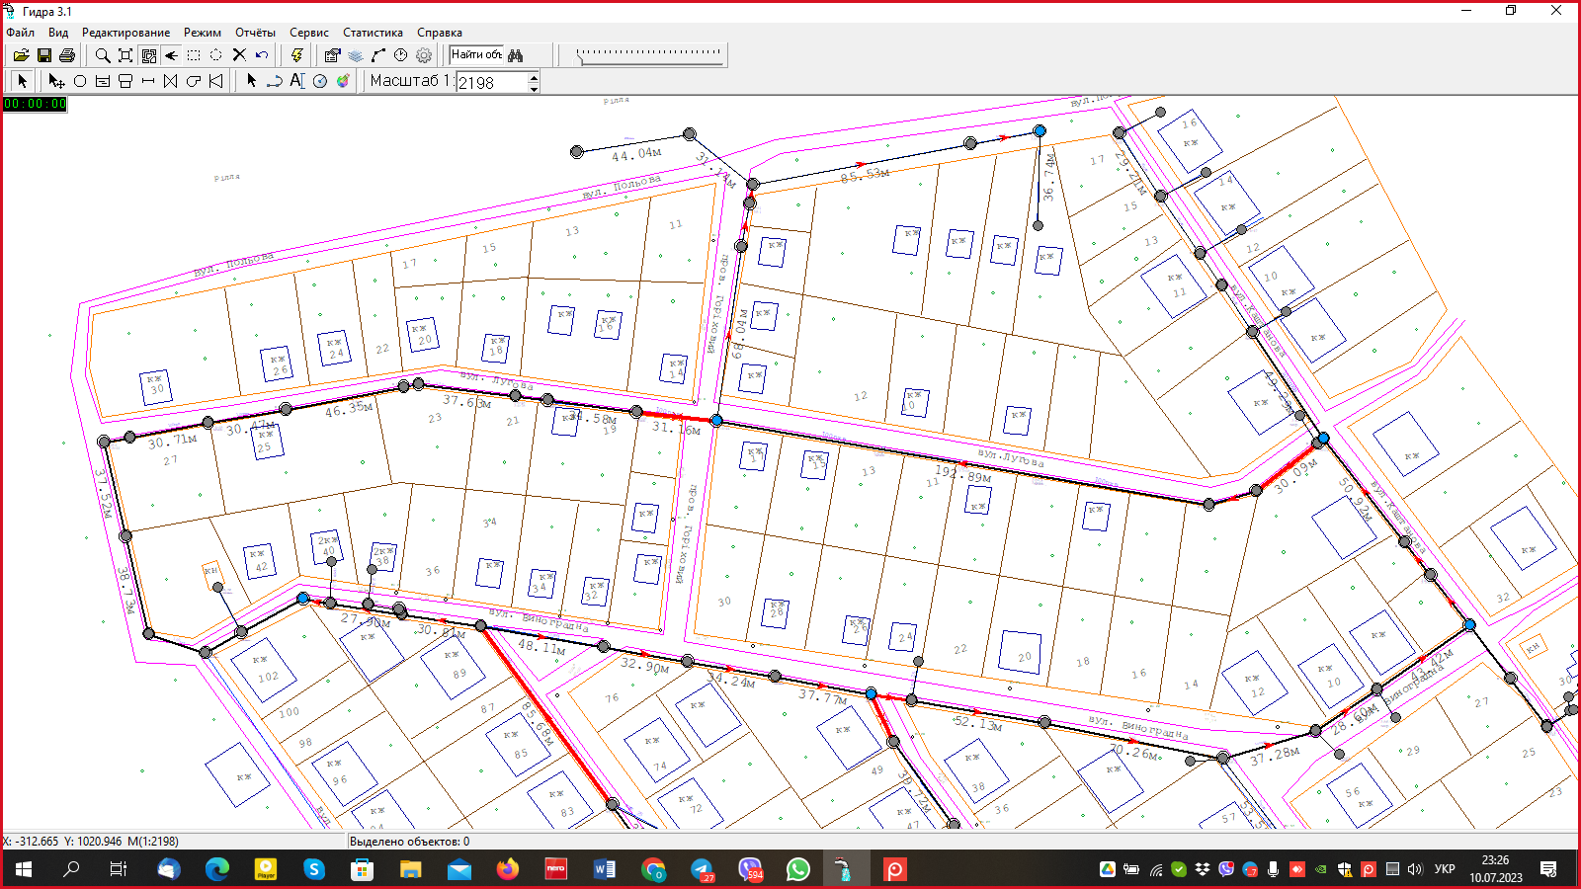
Fig. 3.2. City district with identification and mapping of sections of the water supply network that have been destroyed as a result of hostilities.

Slide 18
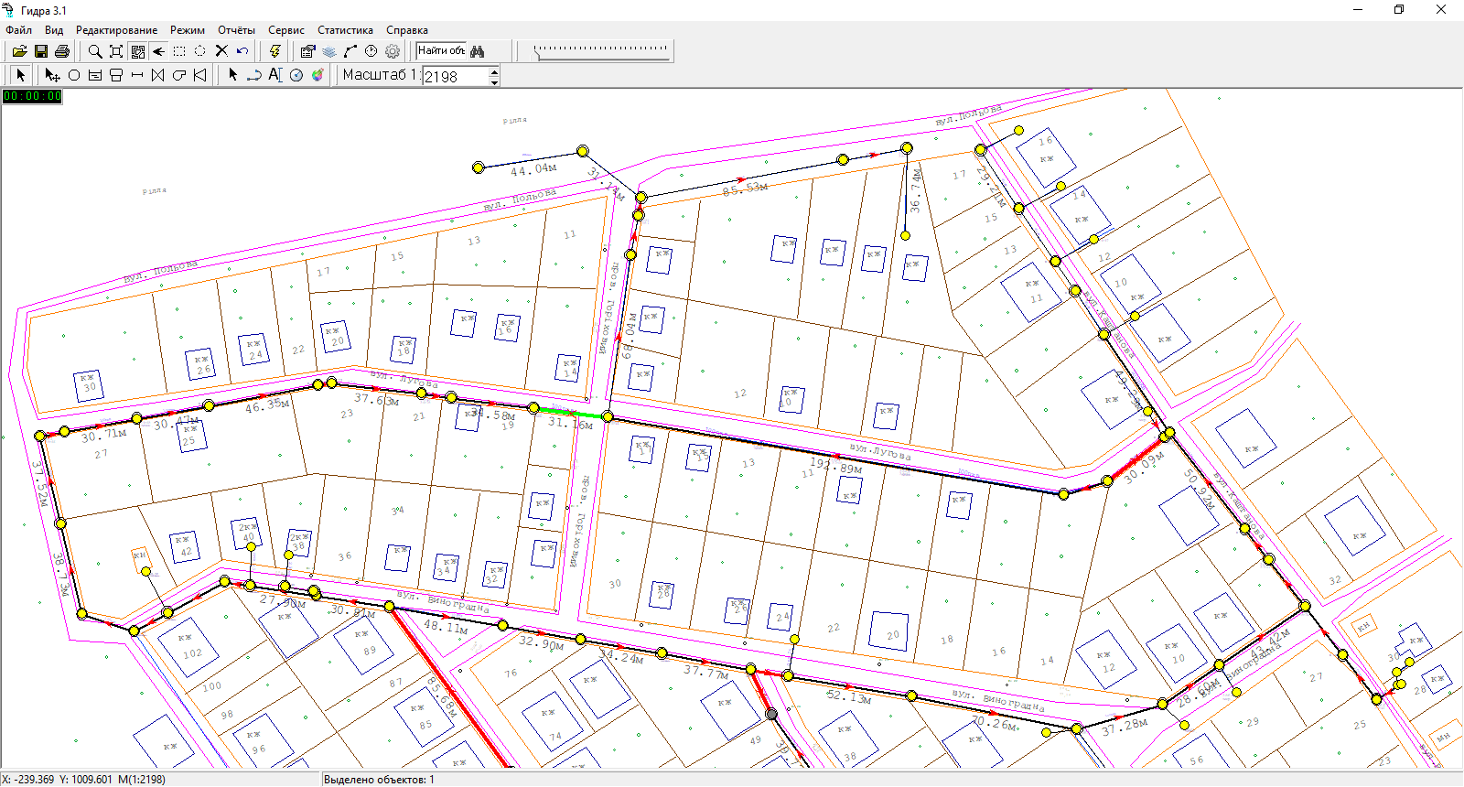
Fig. 3.3. As a result of hydraulic modeling, participants without water supply were identified (yellow dots - consumers without water).

Slide 19
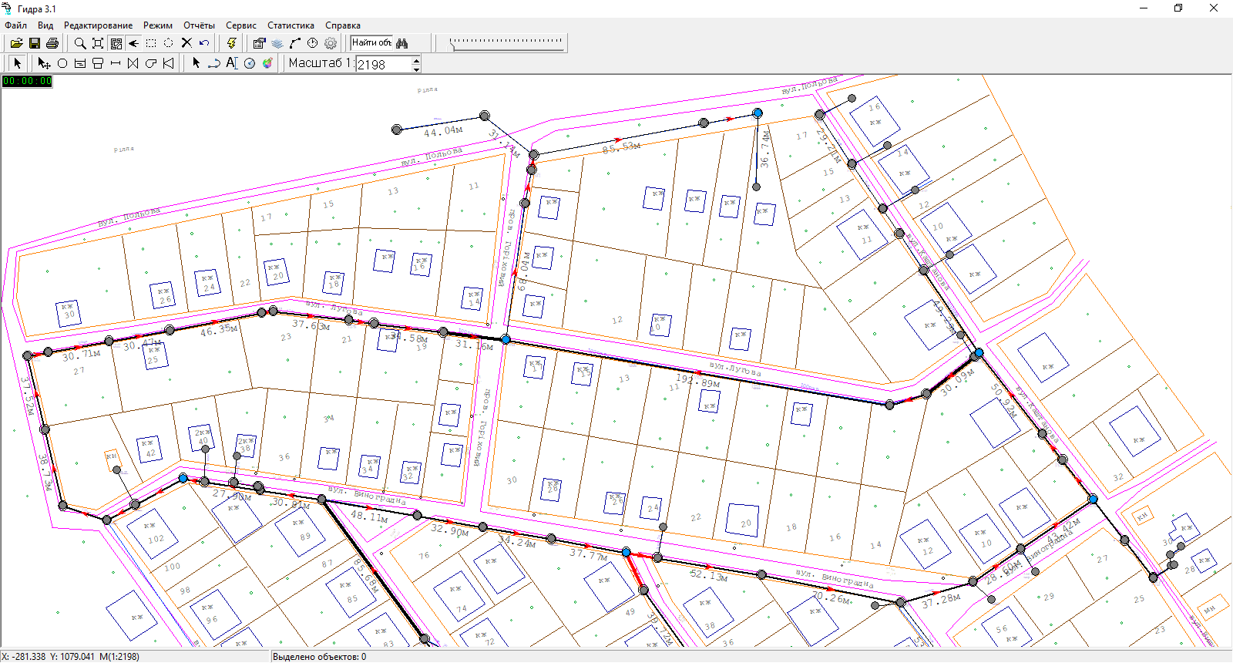
Рис 3.4. Identification of three destroyed sections of the network of the district with a length of 85.2 m; 31.4 m; 30.14 m, the replacement of which made it possible to supply water to each consumer.

Slide 20
In this way, for any settlement under consideration, you will receive an adequate hydraulic model that will allow you to optimally select pumps, pipes of the required diameter, installation locations of pressure regulators, etc., which guarantees water supply to consumers.
The developed hydraulic model will allow us to quickly answer the question "what happens if..." and reduce the risks from extraordinary situations (destruction of one of the pumping stations as a result of shelling, power outage in one of the city&apos;s districts, etc.)
In addition, the Consortium can perform GIS work for the organization of centralized water supply and quickly carry out design work using BIM technology.

Slide 21
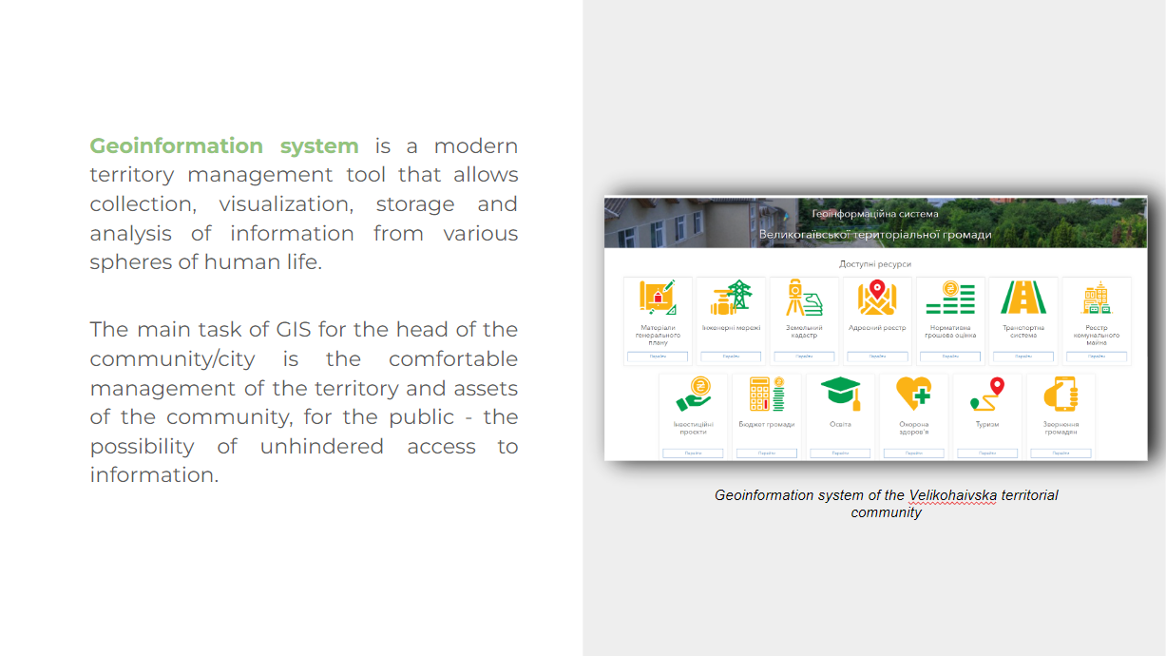

Slide 22
